Slide 1

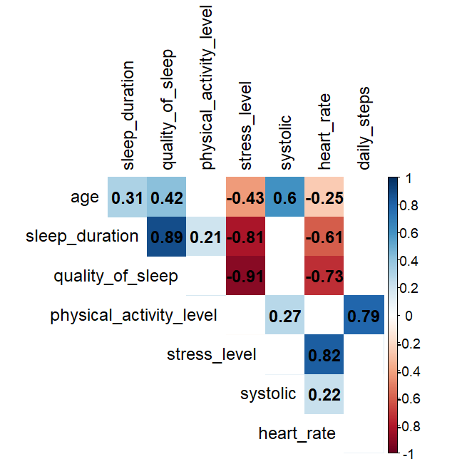
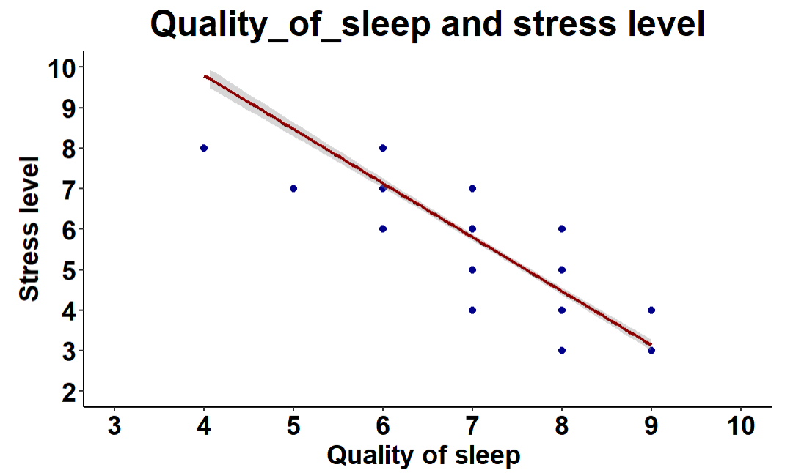
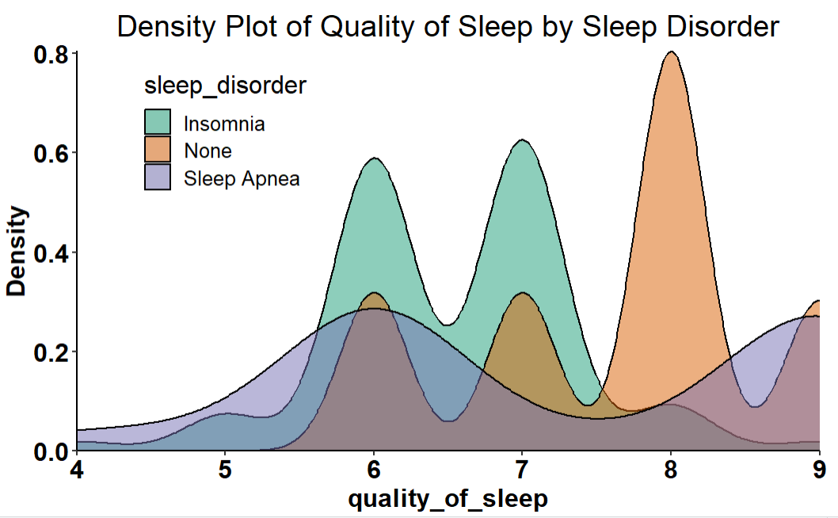
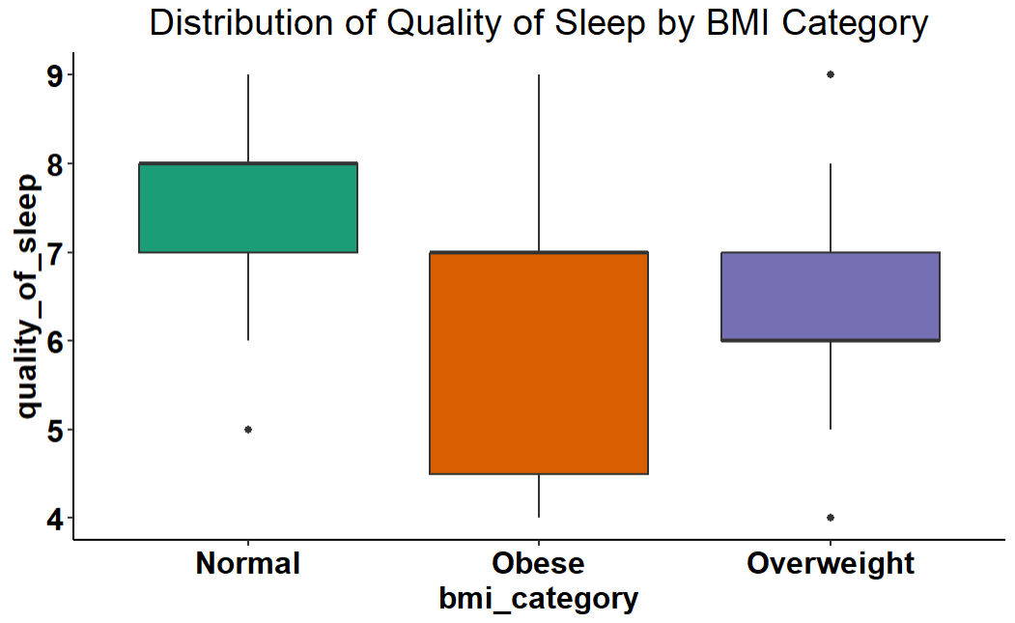

Exploring the Influences on Sleep Quality: Stress Levels, Body Mass Index (BMI) Category, and Sleep Disorders
100-----
University of Derby, Department of Computing and Maths
Abstract
Literature Review
Results/Analysis
Results/Analysis
This study explores the relationship between several factors and how they affect sleep quality. We examine the impact of stress levels, BMI category, and the existence of sleep disorders on the quality of sleep. Through comprehensive analysis, we find insights into how these effects shape individuals' sleep patterns and overall well-being. Understanding these connections is crucial for designing interventions that focus on improving sleep quality and promote positive health outcomes
BMI Category and Sleep Quality:
A research explored the connection between weight and sleep quality while considering the influence of mood and common behaviors like night-eating, lack of exercise, alcohol consumption, and electronic device usage. The findings indicate that an individual's weight might affect their sleep quality independently of these behaviors and mood. Specifically, a higher BMI was associated with increased sleep disturbances and decreased sleep efficiency. (Eid, 2002)
Presence of Sleep Disorders and Sleep Quality:
Sleep disorders, including insomnia, and obstructive sleep apnea impact sleep quality and overall well-being (A Okuagu, 2017)
Upon examination of the correlation matrix, it became evident that there exists a negative correlation between stress level and quality of sleep. Further visual analysis through regression line plotting revealed a distinct pattern: increased stress levels correspond to lower sleep quality.
A similar statistical analysis was conducted to explore the relationship between sleep quality and sleep disorder. A Kruskal-Wallis test yielded a p-value of 2.094e-11, indicating inequality among the medians of the sleep disorder groups. Pairwise Wilcoxon tests revealed an exceptionally small p-value for the comparison between Insomnia and No sleep disorders ('None'), suggesting compelling evidence of significant differences in sleep quality distributions between these two conditions. Moreover, visualizations, such as density plots, illustrated that the density curve for insomnia peaked at lower sleep quality scores, indicating a higher prevalence of poor sleep quality in individuals with insomnia.
Introduction
In recent years, Understanding the connections between sleep quality and overall health has gained significant recognition. Although the quantity of time spent sleeping is important, how those hours are spent is just as important as the benefits we derive from sleep. Attaining high sleep quality is essential for mental, physical, and emotional advantages necessary for optimal functioning. A person's total sleep experience is influenced by several factors related to sleep quality, such as awakenings, sleep efficiency, waking following sleep initiation, and sleep delay. (National Sleep Foundation, 2024).
This study aims to investigate how different factors interact and their influence on sleep quality. Using the Sleep Health and Lifestyle dataset from Kaggle (THARMALINGAM, 2023), we investigate three key factors: stress levels, BMI category, and the presence of sleep disorders. We hope to learn more about how each of these variables affects sleep quality in an individual.
Methods
This Study uses the Sleep Health and Lifestyle dataset from Kaggle. The dataset comprises 374 rows and 13 columns, with a diverse range of variables related to sleep habits, lifestyle factors, and health indicators. It includes details such as gender, age, occupation, sleep duration, quality of sleep, physical activity level, stress levels, BMI category (e.g. Normal, Obese, and Overweight), blood pressure(systolic/diastolic), heart rate, daily steps, and the presence or absence of sleep disorders (e.g. none, Insomnia and Sleep Apnea). Three primary variables of interest were selected from the dataset for analysis: stress levels, BMI category, and sleep disorders.
Correlation and regression analyses were used to examine the relationship between stress levels and sleep quality. The Kruskal-Wallis test was used to assess significant differences in sleep quality among different BMI Categories (Bobbitt, 2019). Pairwise Wilcoxon tests were then conducted to compare sleep quality between BMI categories. The distribution of sleep quality by BMI category was visualized using a boxplot. Similar to the analysis for the BMI category, the Kruskal-Wallis test was utilized to evaluate a significant difference in sleep quality between individuals with and without sleep disorders. Pairwise Wilcoxon tests were conducted for specific comparisons and the distribution of sleep quality by sleep disorders was visualized using a density plot. All statistical analyses were performed using R, a powerful programming language.
A Kruskal-Wallis test was conducted to ascertain if there were statistical differences in sleep quality among the three BMI categories, using a significance level of 0.05. The null hypothesis is that the medians of each group were equal. The resulting p-value, 5.904e-09, was exceptionally small, leading to the rejection of the null hypothesis, indicating unequal group medians. Additionally, a pairwise Wilcoxon test was employed, revealing significantly low p-values for both the normal vs. obese and overweight vs. obese comparisons, signifying substantial differences in sleep quality. The statistical analyses suggested that individuals in the obese category experienced the poorest sleep quality. This observation was further supported by visualizations, illustrating that the median sleep quality for individuals with obesity fell below that of the other two BMI categories.
Conclusion
Stress and Sleep Quality: Our analysis uncovered a robust negative correlation between stress levels and sleep quality. This suggests that increased stress is inseparably linked to poorer sleep outcomes, emphasizing the importance of stress management in improving sleep health.
BMI and Sleep Quality: We identified significant differences in sleep quality across BMI categories using statistical tests such as Kruskal-Wallis and pairwise Wilcoxon. Notably, obese individuals had significantly lower sleep quality than those classified as normal or overweight.
Sleep Disorders and Sleep Quality: A comparison of sleep quality among various sleep disorders revealed significant differences, particularly between individuals with insomnia and those without sleep disorders ('None'). Insomnia was linked to a higher prevalence of poor sleep quality.
Literature Review
Stress Levels and Sleep Quality:
Research suggests a bidirectional relationship between stress and sleep quality, with higher stress levels correlating with poorer sleep outcomes (Y Yap, 2018).
In a study, it was found that there was a correlation between poor sleep quality and heightened stress levels. Around 77% of the participants experienced poor sleep quality, while 63.5% reported experiencing some degree of stress. (Feifei Wang, 2021)
References

